Slide 1

Will Beer – Consultant in Public Health
Aneurin Bevan Gwent Public Health Team

Slide 2
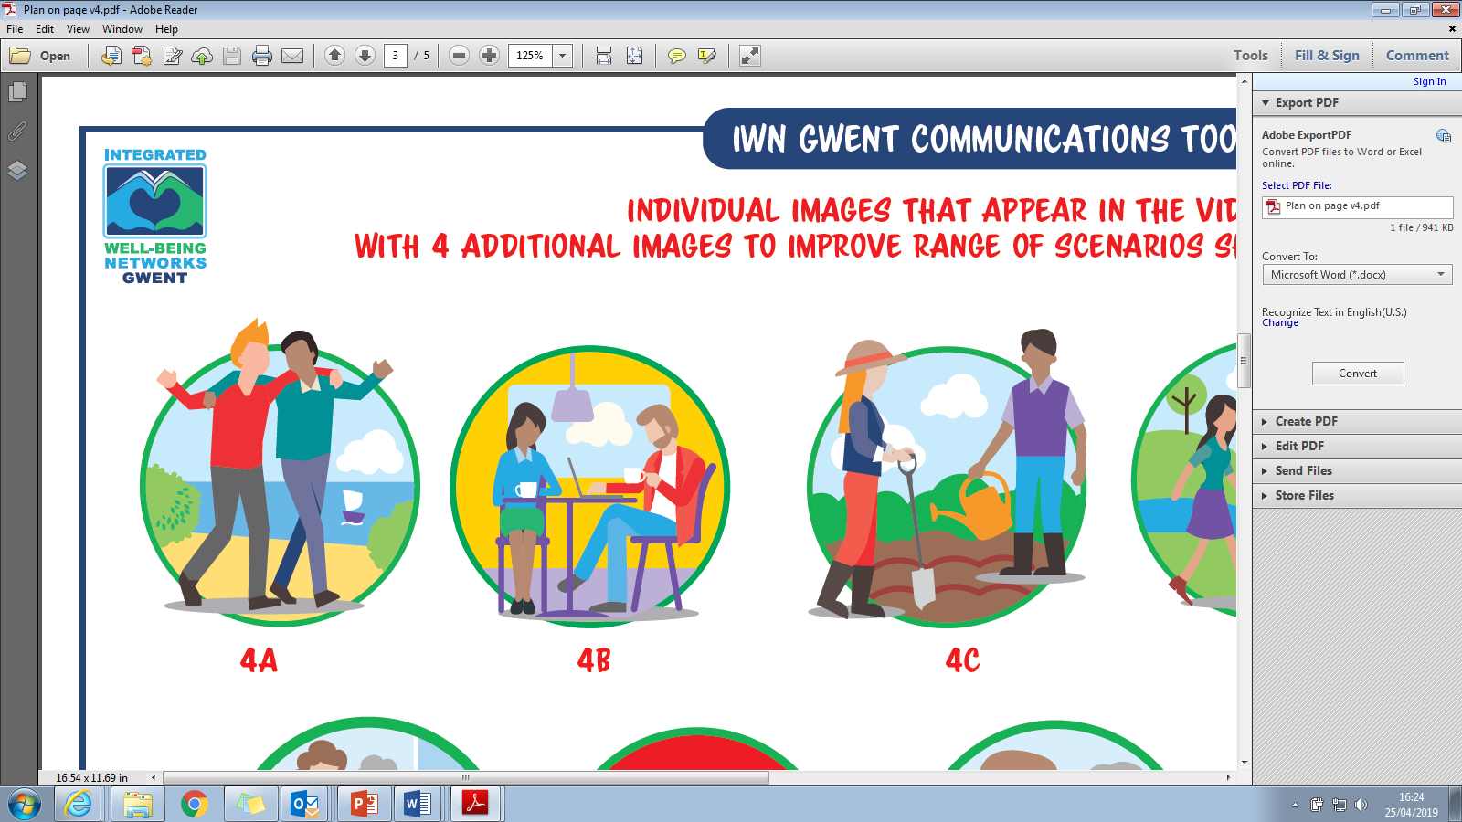

Resources for Community Well-being
PEOPLE
RELATIONSHIPS, KNOWLEDGE AND SKILLS
Notes:
We know we have lots already out there that improves community well-being
Strengths and assets in the community
However, what we have discovered in our scoping work is that these things are not very well connected and visible to people. Symptoms of this include:
Constant need to map and create directories
GPs not being able to keep up with the plethora of services out there and not knowing where to signpost patients for non-medical support
Members of the public not being able to find support when they need it and often being passed around services and professionals
Professionals don’t always know where to signpost people, especially outside of their own sector
Things not being publicised effectively
Professionals not able to use social media due to organisational policy

Slide 3
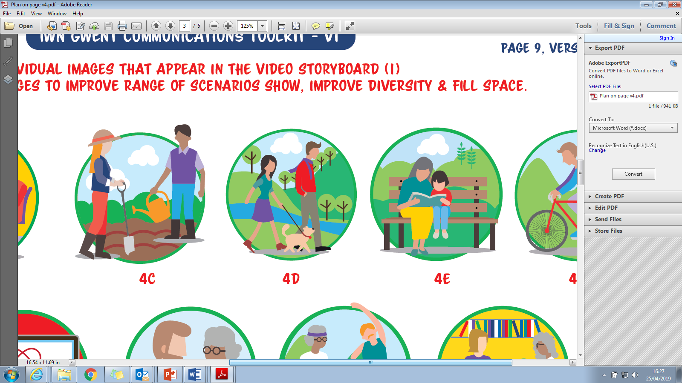
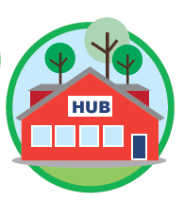
Resources for Community Well-being
PLACES
HEALTHY PEOPLE NEED
HEALTHY PLACES

Slide 4
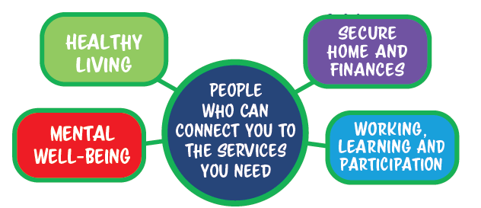
Resources for Community Well-being
PROVISION
WELL-BEING SUPPORT AND SERVICES

Slide 5
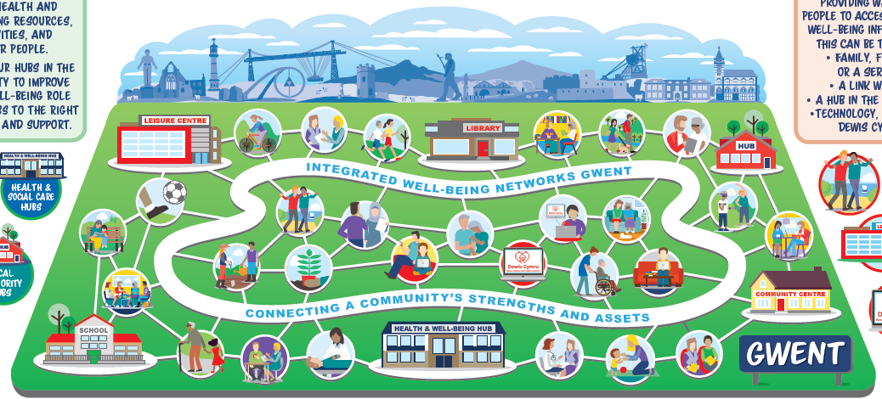
INTEGRATED WELL-BEING NETWORKS
AIM: DEVELOP A PLACE-BASED APPROACH TO IMPROVING
WELL-BEING FOR THE WHOLE POPULATION
Notes:
Aim: Develop a place-based approach to improving well-being for the whole population

Slide 6

1. PLACE-BASED COLLABORATION j:
KEY ACTIONS
ESTABLISH PLACE BASED WELL-BEING NETWORKS
BUILD RELATIONSHIPS
  UNDERSTAND WELL-BEING RESOURCES
  SMALL PROJECTS TESTING CHANGES
  ALIGN PROGRAMMES – POOL RESOURCES
EMBED COMMUNITY ENGAGEMENT
ASSETS BASED COMMUNITY DEVELOPMENT APPROACHES
Notes:
establish place based well-being networks: anyone involved in well-being is welcome
build relationships and understanding of well-being resources
help shape a well-functioning place based well-being approach
contribute to small projects testing changes that will improve things for the community
align programmes aimed at promoting well-being or place-based working – pooling our resources
identify community engagement activity to ensure the community’s voice is embedded in the place based well-being approach
abcd – community of practice

Slide 7



2. COMMUNITY-BASED HUBS j
KEY ACTIONS
IDENTIFY OPPORTUNITIES TO EXPAND PUBLIC SECTOR HUBS CONTRIBUTION :
  CONNECTING PEOPLE TO INFORMATION, ADVICE AND ASSISTANCE
  HOSTING WELL-BEING ACTIVITIES & SUPPORTING COMMUNITY CONNECTIONS
  CO-LOCATION OF ORGANISATIONS & BUILDING RELATIONSHIPS
  DEVELOPING LINKS BETWEEN DIFFERENT TYPES OF HUBS IN THE ‘PLACE’
Notes:
Benefits across organisations by collaborating
Identify opportunities to expand public sector hubs contribution to community well-being and the place based approach
Examples
Connecting people to well-being information, advice and assistance
Hosting well-being activities & supporting community connections and aspirations
Co-location of organisations & building relationships
Developing links and collaboration between different types of hubs in the ‘place’

Slide 8

3. PEOPLE WHO DELIVER SERVICES & SUPPORT
KEY ACTIONS
DEVELOP A JOINED UP APPROACH TO LINKING PEOPLE FROM HEALTH AND CARE SERVICES TO WELL-BEING SUPPORT
MAP ‘WELL-BEING WORKFORCE’ IN EACH PLACE-BASED WELL-BEING NETWORK
DEVELOP TRAINING MENU – KNOWLEDGE & SKILLS TO SUPPORT SOMEONE’S WELL-BEING OR HELP THEM FIND A WELL-BEING RESOURCE
  ACTIVE SIGNPOSTING
  STRENGTHS-BASED AND BEHAVIOUR CHANGE APPROACHES
  MENTAL WELL-BEING
SHARED VALUES
Notes:
develop a joined up approach to linking people from health and care services to well-being support
map ‘well-being workforce’ in each place-based well-being network
develop training menu – knowledge & skills to support someone’s well-being or help them find a well-being resource
active signposting
strengths-based and behaviour change approaches
mental well-being
shared values

Slide 9
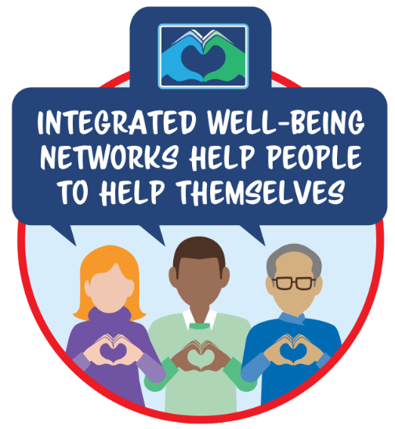

4. EASY ACCESS TO WELL-BEING INFORMATION
KEY ACTIONS
MAP EXISTING APPROACHES TO COMMUNICATION
DEVELOP COMMUNICATIONS PRODUCTS / METHODS
RENEW COMMUNITY HEALTH CHAMPIONS
SUPPORT DEWIS
Notes:
Map existing approaches to communicating well-being information
Develop a range of communications products / methods
Renewed community health champions programme – peer to peer
Support to promote and establish dewis

Slide 10
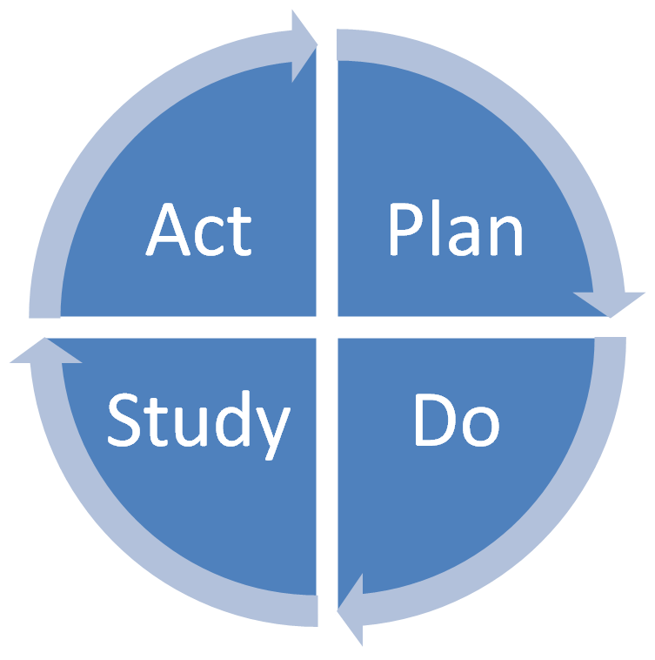
Ways of working
Assumption – we are all aiming to impact upon community well-being…can we be more successful by working collectively?
Using what we already have first and foremost – connecting and aligning programmes
LSC principles:
  Changing mindsets, processes, relationships
  Shared vision – something worth striving for
  Accepting complexity – not just structures – also behaviours
  Devolve leadership for improvement
  Using improvement approaches – Plan, Do, Study, Act cycle

Slide 11
Structure
Integrated Partnership Boards to drive programme in each locality
Alignment to PSB agenda
Proposed initial areas of focus for delivery:
NCN Area
Caerphilly North | Aligned with Rhymney & Bryntirion primary care transformation developments
Caerphilly South | Aligned with Lansbury Park Deep Place Plan
Newport East | Aligned with Ringland Health and Well-being Centre development
Blaenau Gwent East | Aligned with Brynmawr Resource Centre development
Blaenau Gwent West | Aligned with Tredegar Health and Well-being Centre development
Torfaen North | Aligned with Blaenavon place-based pilot
Monmouthshire South | Aligned with the South Monmouthshire Health, Well-being and Social Care Project

Slide 12
Evaluation
We won’t affect change to individual well-being in 12 months
Developing a theory of change describing how system level changes will lead to improvements for people in our communities
System-level indicators that will tell us change is happening:
  Shared vision, common understanding, joint approach
  Shared approach to tracking progress towards outcomes (things that have meaning and matter to people)
  Co-ordinated plan of mutually reinforcing activities
  Consistent and open communication to build trust and common motivation
  ‘Backbone support’ – Co-ordinate action across agencies, ensure alignment, project management, joint learning, create an improvement culture, pursuit of new opportunities
Notes:
pursuit of new opportunities for collaborative advantage

Slide 13
IWN Team
Job Title/Role | Name | Email | Base
Executive Lead | Sarah Aitken | Sarah.Aitken@wales.nhs.uk | ABUHB HQ, St Cadoc’s, Caerleon
Public Health Consultant | Will Beer | William.beer@wales.nhs.uk | Victoria House, Newport
Principal Public Health Practitioner / Programme Manager | Gemma Burrows | Gemma.Burrows@wales.nhs.uk | Victoria House, Newport
IWN Project Manager | Amal Shandall | Amal.Shandall@wales.nhs.uk | Victoria House, Newport
Blaenau Gwent Service Development Lead | Kath Cross | Kathryn.Cross@wales.nhs.uk | VITCC, Tredegar
Torfaen Service Development Lead | Emma Davies | Emma.Davies70@wales.nhs.uk | County Hospital, Griffithstown
Caerphilly Service Development Lead | David Llewellyn | David.Llewellyn@wales.nhs.uk | Foxes Lane, Oakdale
Newport Service Development Lead | Marietta Evans | Marietta.Evans@Wales.nhs.uk | Civic Centre, Newport
Monmouthshire – Changing Practice, Changing Lives Lead | Nicki Needle | NicolaNeedle@Monmouthshire.gov.uk | Mardy Park, Abergavenny
Community Development & Engagement Officer | Victoria Price | Victoria.Price2@wales.nhs.uk | Victoria House, Newport
Well-being Workforce | Shareen Ali | Shareen.Ali@wales.nhs.uk | Victoria House, Newport
Community Health Champions | Emma Palmer | Emma.Palmer@wales.nhs.uk | Victoria House, Newport

